Slide 1

Network Anomaly detection in Healthcare IOT environment
School of Computer Science and Engineering, Department of Computer Science and Engineering
Submitted By: ISHIT KAUSHIK
Registration No. 2427030038
Supervised By: Dr. Usha Jain

Slide 2
Introduction
The rise of Healthcare IOT (H-IOT)
The healthcare sector remains one of the fastest to adopt and adapt to IOT, with the recent advances in IOT, sensors and AI to transform and revolutionize electronic healthcare into a connected ecosystem.
Through smart devices, wearable sensors, and connected medical equipment, hospitals can now collect real-time data such as heart rate, blood pressure, and oxygen levels directly from patients.
This network of smart and connected devices will collect the data automatically, that can be controlled remotely across the existing Network Architecture, then this data can be analyzed by the doctors.
This digital connection offers many benefits, such as remote patient monitoring and telemedicine;
It helps in the early detection of health problems; (advantages)
It helps reduce hospital workload and improves patient care by enabling continuous attention and personalized treatment for every patient. (benefits and opportunities)

Slide 3
Security concerns and issues
The rapid growth of IoT devices in healthcare has created serious security risks.
Current trends and challenges in H-IoT stress the importance of intelligent intrusion detection.
Existing intrusion detection systems often fail to identify new or evolving cyberattacks because they lack adaptability and struggle with complex data.
A successful network anomaly, such as a DOS attack, could disrupt the communication of critical H-IoT devices like remote monitors and connected medical equipment.
This loss of real-time connection would prevent doctors from analyzing automated data and could stop continuous attention and personalized treatment, negating it’s main benefits

Slide 4
Why focus on DDOS attacks ?
DDoS attacks are the most common and most harmful attacks in IoT and healthcare networks.
They come from many infected devices at once, flooding the target with massive traffic and disrupting critical medical communication. Even a few seconds of downtime can affect patient safety.
DDoS patterns are also easier to study for deep learning models, making them suitable for a research-based project. Focusing on DDoS keeps the work clear, manageable, and directly relevant to real IoT security issues.
Other types of IoT attacks : brute-force attacks and malware-based attacks;
In a brute-force attack, the attacker keeps trying different passwords until one works. Many IoT devices still use weak or default passwords, making them easy to break into and allowing attackers to gain full control.
Malware attacks, such as the Mirai botnet, infect IoT devices like cameras and routers and turn them into bots. These infected devices are then used to launch large DDoS attacks, making Mirai one of the most dangerous threats to IoT and healthcare networks.

Slide 5
Problem Statement
The rapid growth of IoT devices in healthcare has improved patient monitoring and data management.
However, it has also created serious security risks.
Current intrusion detection systems often fail to identify new or evolving cyberattacks because they lack adaptability and struggle with complex data.

Slide 6
Objectives
Reduce false alarms and maximize the correct classification of network traffic.
Provide fast, reliable attack predictions for immediate, practical deployment.
Integrate DeepCLG (CNN+LSTM+GRU) with attention mechanisms to selectively focus on and capture complex spatio-temporal threat patterns.

Slide 7
Proposed Methodology
Data Collection, Preprocessing & Splitting
The data is gathered and prepared to ensure quality and consistency. It goes through cleaning, standardization, and encoding to remove errors and make it suitable for analysis.
The refined data is then divided into training, validation, and testing sets to support accurate and balanced model learning.
Model Development & Network Integration
The DeepCLG hybrid model combines CNN, LSTM, and GRU to capture patterns and sequences in the data.
Its strengthens the understanding of data relationships and helps detect both known and new attacks accurately.
Prediction & Evaluation
The model classifies network traffic as Normal or Attack. The performance is checked using accuracy, precision, recall, and F1-Score to ensure reliability.

Slide 8
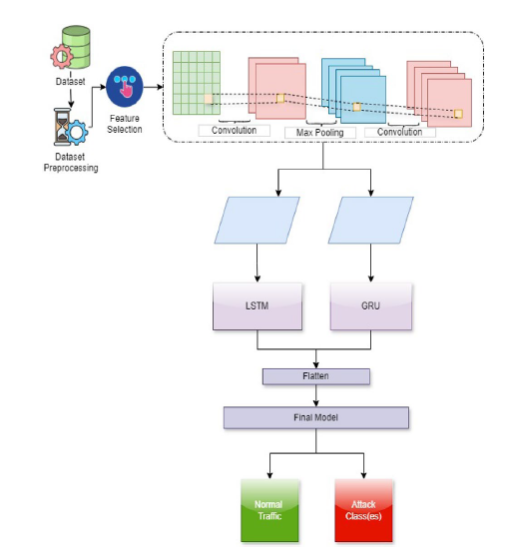
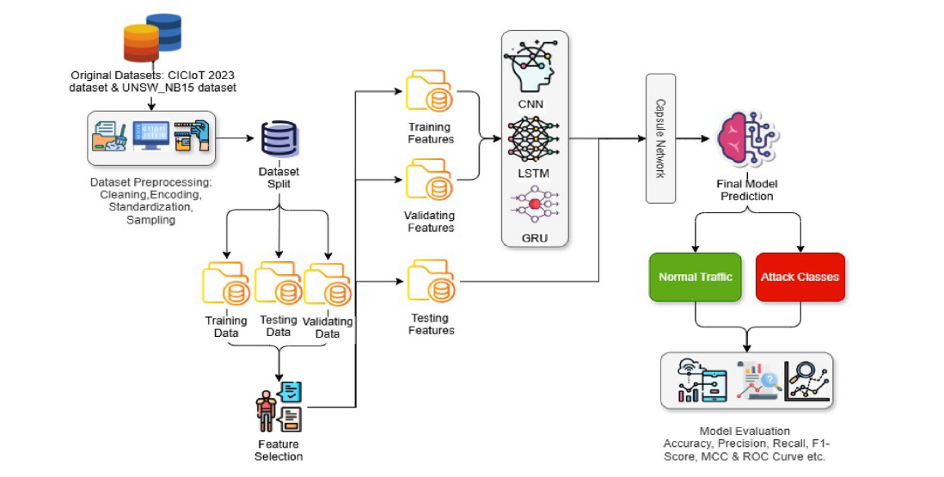
Fig : the methodology of the proposed model
Fig : the proposed DeepCLG model architecture

Slide 9
The project effectively explored the security challenges in Healthcare IoT systems and demonstrated how deep learning can enhance intrusion detection.
By analyzing the hybrid DeepCLG model, the study showed that combining CNN, LSTM, and GRU helps capture both spatial and temporal patterns more efficiently than traditional methods.
Using the CICIoT2023 and UNSW-NB15 dataset with proper preprocessing further strengthened the model’s reliability.

Slide 10
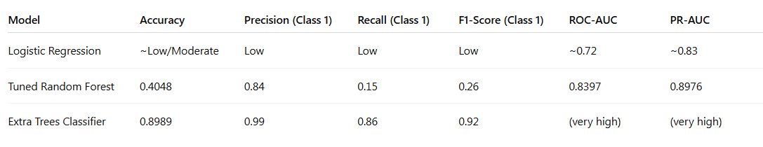
Result
three models were tested on the UNSW-NB15 dataset for intrusion detection;
Logistic Regression was used as the baseline model, but it gave low performance because it cannot handle complex network patterns properly. After that, Random Forest was applied and tuned using RandomizedSearchCV. It improved precision but recall was still very low, meaning many attacks were not detected. Finally, the Extra Trees Classifier gave the best results with high accuracy, precision, recall, and F1-score.
Fig : a comparison table based on the performance of the models (results for class 1 data)

Slide 11
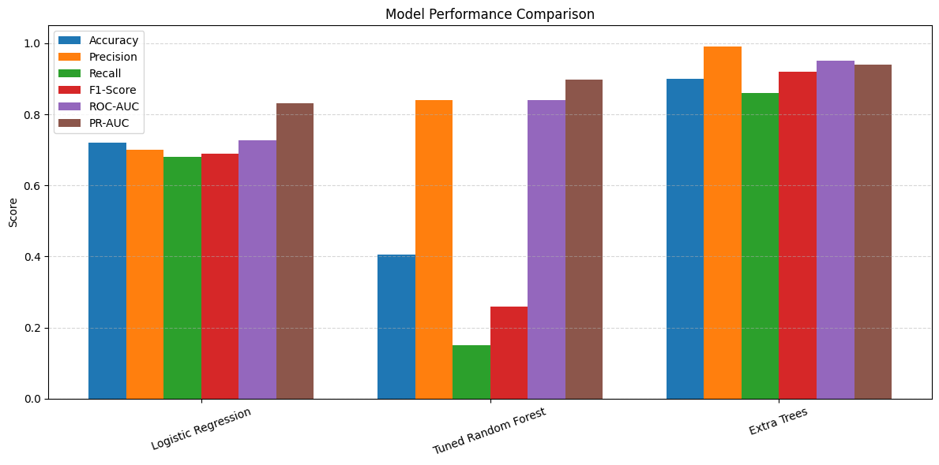

Slide 12
LSTM (Long Short-Term Memory)
LSTM is a recurrent neural network architecture designed to capture long-range sequential dependencies while avoiding the vanishing gradient problem. It employs three gates - forget gate (f), input gate (i), and output gate (o), along with a cell state (c) to selectively retain and update information.
GRU (Gated Recurrent Unit)
GRU is a simplified variant of LSTM with only two gates: an update gate (z) and a reset gate (r). By merging the forget and input gates, GRU achieves comparable performance to LSTM with fewer parameters, resulting in faster training.

Slide 13
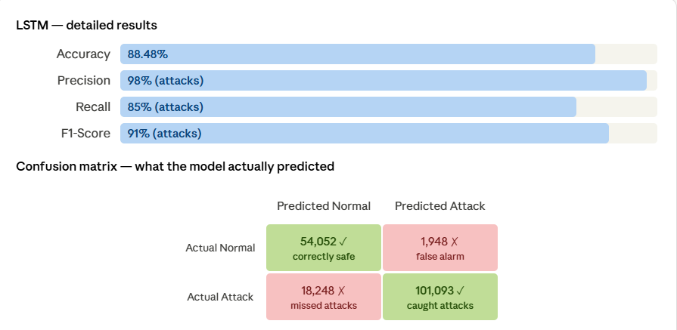
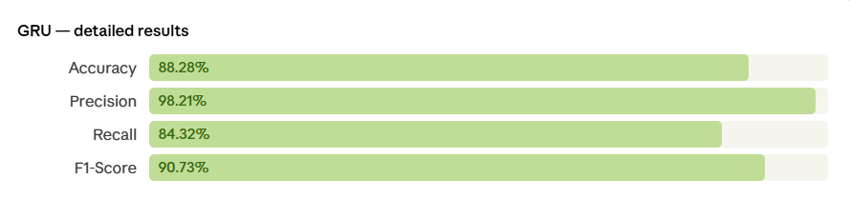

Slide 14
Outcomes
the real time deployment of the model (partially completed) A Machine Learning based Network Intrusion Detection System (NIDS) has been developed using the UNSW-NB15 dataset. The system successfully classifies network traffic as normal or attack using models like Logistic Regression, Random Forest, and Extra Trees Classifier.
achievement of my outcome I was able to inculcate the Extra Trees Classifier, which in return provided me with the best results, accuracy and balanced performance based on Precision, Recall, F1-score, ROC-AUC and PR-AUC metrics.
the future scope of the project The developed model can be extended for real-time intrusion monitoring and deployment in cybersecurity environments.

Slide 15
References
Enhancing network security in industrial IoT environments: a DeepCLG hybrid learning model for cyberattack detection - Gulzar, Q., Mustafa, K. ;
(published: 24 January 2025)
International Journal of Machine Learning and Cybernetics
Security and Privacy Issues with IoT in Healthcare - Chacko, Anil; Hayajneh, Thaier.
(published: Jul 2018).
EAI Endorsed Transactions on Pervasive Health and Technology; Ghent Vol. 4, Iss. 14.
Fordham Center for Cybersecurity, Fordham University, New York, NY, USA
M. Adil et al., "Healthcare Internet of Things: Security Threats, Challenges, and Future Research Directions," (published : 1st June, 2024)
IEEE Internet of Things Journal, vol. 11, no. 11

Slide 16
Thank You !

